Slide 1
NODE.JS
(The Backend Of MERN Stack)
Lecture 17

Slide 2
Today’s Agenda
What Is An API ?
What Is REST ?
What Is RESTful ?
Api Endpoint
Examples Of API Endpoints
What is Routing?
Components of a Route
Http Methods
Examples Of Routes

Slide 3
What is an api ?
API is the acronym for Application Programming Interface, and is a software intermediary that allows two applications to talk to each other.
In simple terms an API is defined as a code that helps two different software’s to communicate and exchange data with each other.

Slide 4
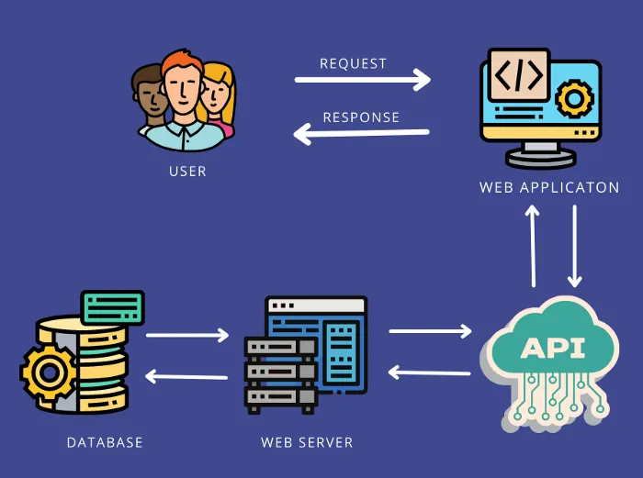
What is api ?

Slide 5
An example
If a user wants to book train tickets, he will visit makemytrip.com and click on trains link.
The makemytrip web application will accept source and destination cities and will display all the trains available.
But how makemytrip.com shows these details because they are stored in irctc’s server and not at makemytrip’s server as it doesn’t own/run any trains ?

Slide 6
An example
The answer is API .
The developer of makemytrip.com web application connects to the irctc.co.in web server through irctc’s API to get these train details.
Then the developer can display that data in his makemytrip.com application.

Slide 7
Some more examples
Google Maps API’s allow developers to embed Google Maps on webpages by using JavaScript.
YouTube API allows developers to integrate YouTube videos and functionality into websites or applications.
Amazon’s API gives developers access to Amazon’s product selection.

Slide 8
What is rest ?
REST stands for Representational State Transfer, and it is an architectural style or a set of rules that developers follow when they create their own API .
Its principles were formulated in 2000 by computer scientist named Roy Fielding and gained popularity as a standard method of machine-to-machine communication.

Slide 9
Why it is called rest ?
In a client-server communication, REST suggests to create an object of the data requested by the client and send the values of the object in response to the client.
For example, if the user is requesting for getting details of a movie which is currently played at DB Mall , Bhopal, then we can create an object on the server-side, store movie details in it and transmit it to the client .

Slide 10
Why it is called rest ?
So, over here, we have an object and we are sending the state of an object.
This is why REST is known as Representational State Transfer.

Slide 11
What is restful api ?
REST is the most common standard used between Clients (a person or application) who want to access information from the web from Servers (application or database) who have access to that information.
Now , if we develop an API that follows the REST standard it will be called RESTful.

Slide 12
What is restful api ?
A REST/RESTful API is based on the universal HTTP protocol, and the information is usually returned in the JSON format that almost all of the programming languages can read.
Thus it can be used by any site or application no matter what language it is written in because almost all of the programming languages can generate HTTP Request and can read JSON data

Slide 13
Methods of rest api
All of us working with the technology of the web, do CRUD operations.
When we say CRUD operations, we mean that we create a resource, read a resource, update a resource and delete a resource.
Now, to do these actions, we can actually use the HTTP methods, which are nothing but the REST API Methods.

Slide 14
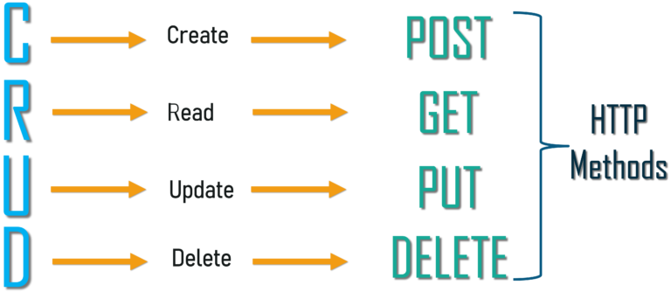
Methods of rest api

Slide 15
What is api endpoint ?
An API endpoint is a digital location where an API receives requests about a specific resource on its server.
In APIs, an endpoint is typically a uniform resource locator (URL) that provides the location of a resource on the server.

Slide 16
Api endpoint examples
Twitter API Endpoint Example
The Twitter API exposes data about tweets, direct messages, users, and more.
Suppose we want to retrieve the content of a specific tweet.
To do this, we can use the endpoint, which has the UR: https://api.twitter.com/2/tweets/{id} (where {id} is the unique identifier of the tweet).

Slide 17
Api endpoint examples
GitHub API Endpoint Example
The GitHub API exposes data about its users , their repos , their subscriptions, events and more.
Suppose we want to retrieve the details of a specific github profile.
To do this, we can use the endpoint, which has the URL: https://api.github.com/users/{username} (where {username} is the github usernameof the person).

Slide 18
What is routing in express ?
In Express the term, Routing refers to the mechanism that determines how an application responds to a client request to a particular path/api endpoint and a specific HTTP request method (GET, POST, and so on).
In simple terms, routing is controlling which function gets invoked whenever the user navigates to a particular URL using a particular HTTP method .

Slide 19
Components of a route
A route/api endpoint is made up of 3 major components:
Http Method
Main url
Resource
There are other elements also in a route
For example , if the route carries data , then it will contain route parameters , but the above 3 are major components of a route.

Slide 20
What are http methods ?
Http methods are actions that can be performed on a resource.
The most common Http methods are:
Http Method | Purpose
GET | For getting some data from the server
POST | For creating new data at the server
PUT | For updating data at the server
DELETE | For deleting data at the server

Slide 21
Examples of route
Http Method | Main url + resource | Meaning
GET | https://www.scalive.in/courses | Fetch all courses
GET | https://www.scalive.in/courses/101 | Fetch a single course
POST | https://www.scalive.in/courses | Create a new course
PUT | https://www.scalive.in/courses/101 | Update a course
DELETE | https://www.scalive.in/courses/101 | Delete a course

